Slide 1

TIBCO FLOGO
Training Day 4
Trainer: Jaydeep
Date: 10/Jul/2023

Slide 2
Agenda
Information About Connectors:
Connections
Included Connectors
TIBCO Cloud™ Messaging
Message Selection
LAB: Connecting TIBCO Cloud Applications
Create a Publisher App
Create a Receiver App
Push TCMPublisher App
Push TCMReceiver App
Filter TCM Messages

Slide 3
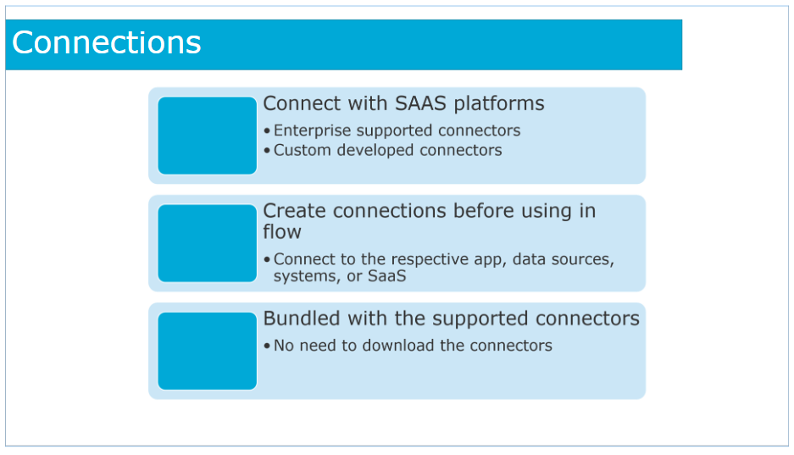
Connections
Connections are used by Flogo® to connect with SaaS platforms. TIBCO Flogo® users can use connectors that have enterprise support and also connectors that are custom developed extensions.
You must create connections before using the connectors in a flow. Flogo® uses the configuration provided in these connections to connect to the respective app, data sources, systems, or SaaS.
TIBCO Flogo® comes bundled with the supported connectors. You do not need to download the connectors.

Slide 4
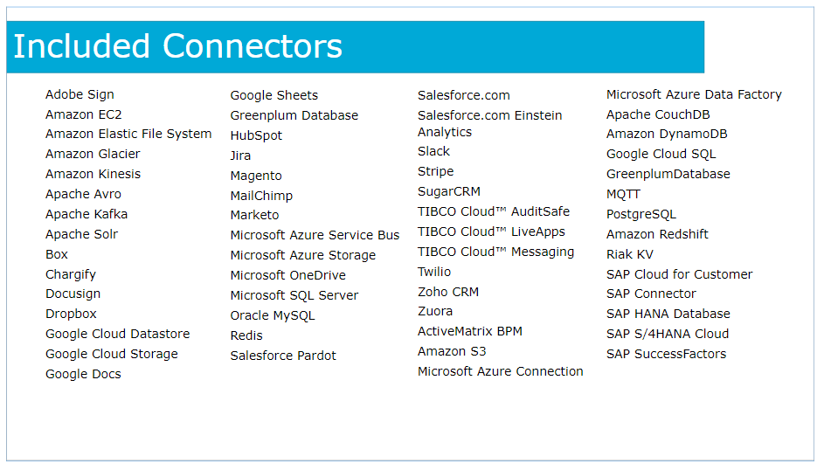
Included Connectors
Shown here are the connections included with TIBCO Cloud Integration - Develop.

Slide 5
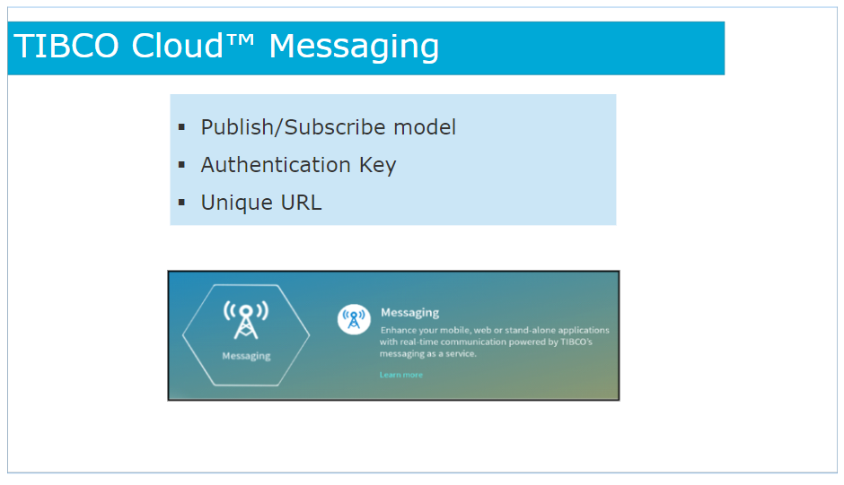
TIBCO Cloud™ Messaging
TIBCO Cloud Messaging provides the infrastructure for developing global applications quickly and easily. With simple-to-use client-side libraries, you can develop secure, high-performance, mobile, web-based, and desktop applications.
TIBCO Cloud Messaging uses a publish/subscribe model for real-time messaging between applications.
Your clients can publish messages with any content, and the subscribing clients receive only those messages whose content matches with the subscribing client's interests.
After you have registered with TIBCO Cloud Messaging, you are ready to start coding. You can do it only when you have an authentication key from your account page.
Connections to TIBCO Cloud Messaging are always persistent, secured with TLS (Transport Layer Security), and authenticated by using the keys managed by you. The user can create and revoke authentication keys when required.
A unique URL is provided to you with your subscription to TIBCO Cloud Messaging. The URL is a required argument for your clients to connect to TIBCO Cloud Messaging.

Slide 6
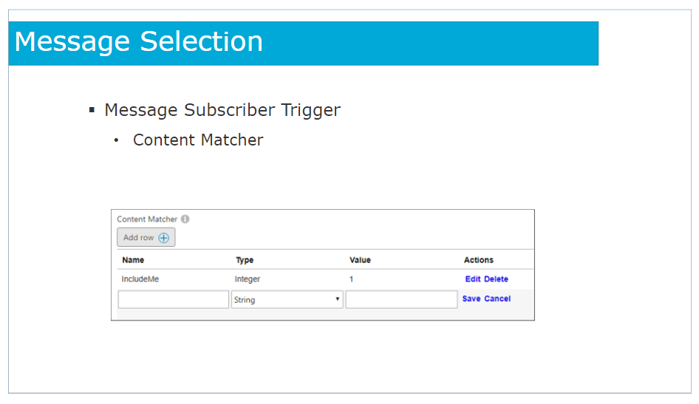
Message Selection
The Message Subscriber trigger listens for a published message from the TIBCO Cloud Messaging service.
Using the Content Matcher in the trigger configuration, specify the attributes to match in the incoming message by clicking on Add row. For each attribute specify its name, type, and value.

Slide 7
TIBCO eFTL™ on TIBCO Cloud™ Messaging
Connecting to TIBCO Cloud Messaging
Client Identifiers
Content Matchers
Durable Subscriptions
Message Size Limit

Slide 8
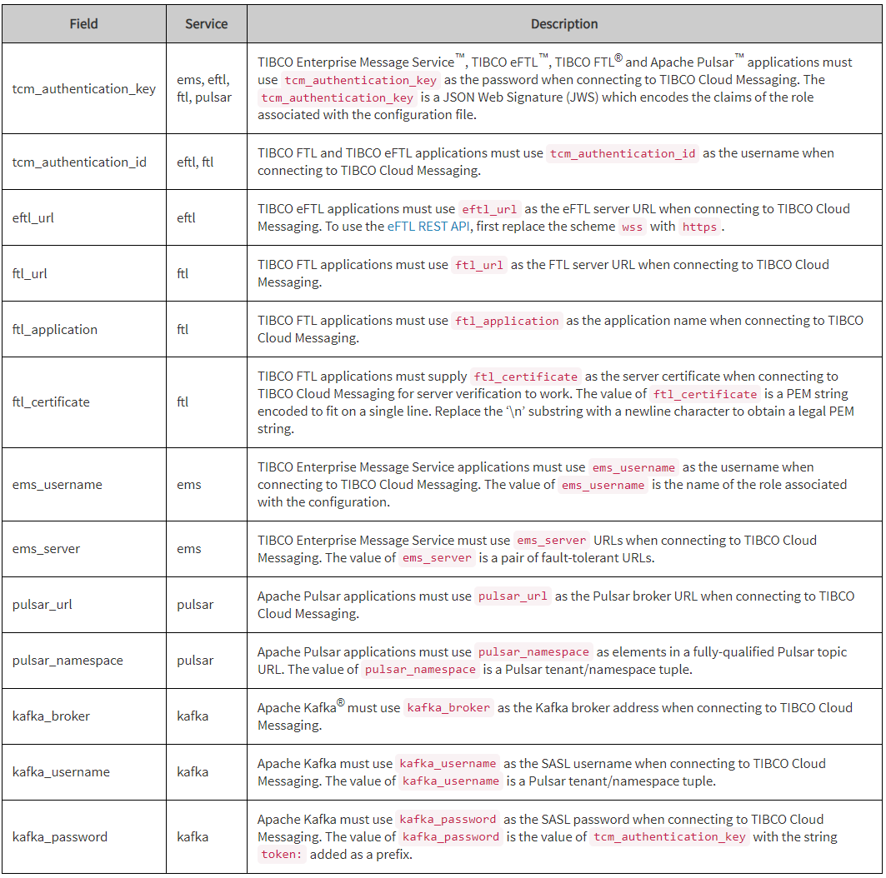
Connecting to TIBCO Cloud Messaging
The client configuration file contains all the information client applications need to securely connect to TIBCO Cloud Messaging.
Generate the client configuration file using the roles REST API or user interface. Generate as many configuration files as needed for each Role.

Slide 9
Client Identifiers
You must provide a unique identifier for your client if you want it to receive any messages missed while disconnected.
Only one application can connect with a given client id at any given time.
If a second application connects with a client id already in use by another application, the first application will disconnect.

Slide 10
Content Matchers
Subscriber objects can specify interest in messages based on their content, that is, based on message fields and their values.
A content matcher selects a subset of messages from a message stream according to the fields and values in those messages.
A subscriber uses a content matcher to express interest in the subset of messages that the content matcher specifies.
Syntax
A content matcher is a JSON object with one or more fieldname:value elements:
{ "fieldname": value }

Slide 11
Durable Subscriptions
All TIBCO Cloud™ Messaging subscriptions are durable in order to guarantee message delivery. A durable subscription preserves messages for disconnected subscribing clients, delivering the messages when the subscribing client reconnects.
TIBCO Cloud Messaging supports the following types of durable subscriptions:
1.Standard
2.Shared
Standard Durables subscriptions are the default durable subscription type and ensures that every message is received and acknowledged by the subscribing client.
A standard durable subscription is available to any subscribing client as long as that client provides the same durable name, and content matcher whenever it connects.
Shared Durables subscriptions can support multiple subscribers simultaneously with each subscribing client receiving a portion of the messages. Shared durable subscriptions are useful to load balance messages across multiple subscribing clients.
A shared durable subscription is available to subscribing clients that provide the same durable name and content matcher, along with setting the durable type property to shared.

Slide 12
Message Size Limit
The message size limit for TIBCO eFTL is 1MB.

Slide 13
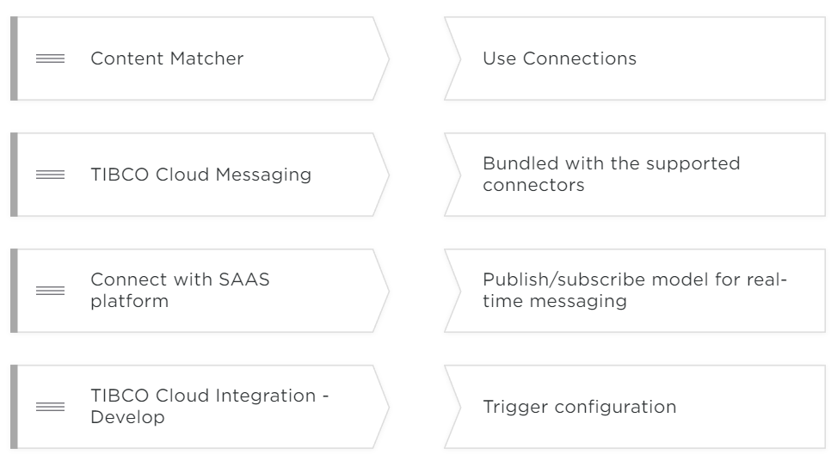
Know Your Knowledge

Slide 14
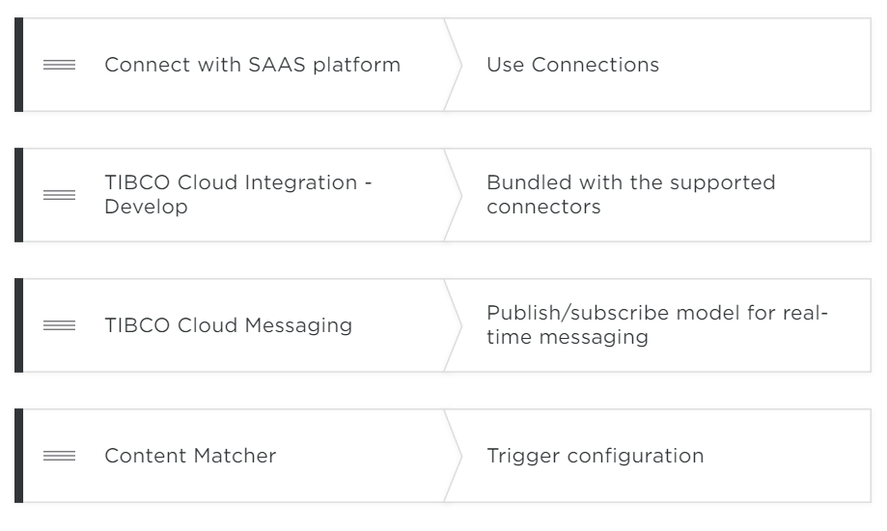

Slide 15
LAB
Create account on TCM:
https://account.cloud.tibco.com/signup/tcm
Create a Role on TCM to connect TCM via Flogo
Create a Publisher App
Create a Receiver App
Push TCMPublisher App
Push TCMReceiver App
Filter TCM Messages

Slide 16
Questions?

